Slide 1


For Real? Auto Insurance Fraud Detection
Ice Asher Chew
Notes:
Automobile

Slide 2
Auto insurance frauds
Inflating claims
Claims for incidents that never occurred
Staging accidents
False reports of stolen vehicles
Notes:
Examples of auto insurance fraud

Slide 3

Auto Insurance Fraud
Inflating insurance claims
Staging accidents
Submitting claim forms for injuries or damage that never occurred
False reports of stolen vehicles
Notes:
What is auto insurance fraud:
Auto insurance fraud ranges from misrepresenting facts on insurance applications and inflating insurance claims to staging accidents and submitting claim forms for injuries or damage that never occurred, to false reports of stolen vehicles.
BI estimates that the total cost of insurance fraud (excluding health insurance) is more than $40 billion per year. (think about the cost of every fraud not just insurance, how big would that be?)
Fraud accounted for between 15 percent and 17 percent of total claims payments for auto insurance bodily injury in 2012, according to an Insurance Research Council (IRC) study. The study estimated that between $5.6 billion and $7.7 billion was fraudulently added to paid claims for auto insurance bodily injury payments in 2012, compared with a range of $4.3 billion to $5.8 billion in 2002.
Bottom line: fraud is on the rise, fraud is expensive
Source: https://www.iii.org/article/background-on-insurance-fraud

Slide 4


How will this affect you!
Notes:
Cut loss = more profit
Fraud is an Imbalance classes prob and imbalance prob are everywhere.
Terrorist, faulty product, high potential employees, rare disease
Same principles and techniques can be applied

Slide 5
Increasing x Expensive
Auto insurance bodily injury fraud accounted for 15% - 17% of total claims payments for in 2012
About $5.6 billion - $7.7 billion was fraudulently added to paid claims for auto insurance bodily injury payments in 2012 ($4.3 billion to $5.8 billion in 2002).
Source: https://www.iii.org/article/background-on-insurance-fraud

Slide 6
Goal Reduce loss = More profit
To build an accurate machine learning model that can detect auto insurance fraud to prevent it, which will
reduces losses for insurance companies.

Slide 7
Criteria for success:
How well model can distinguish fraud vs non-fraud
F1 score > 0.397
ROC AUC score > 0.7
Notes:
Naïve prediction so that no fraud escape
But this is too much wasted resources

Slide 8
About the data
Sample size of 1000
Auto incident claims in 3 states: Ohio, Illinois, Indiana
From 01 Jan 2015 to 01 Mar 2015
39 variables before feature engineering and preprocessing
Data source: https://www.kaggle.com/roshansharma/insurance-claim
Notes:
What is auto insurance fraud:
Auto insurance fraud ranges from misrepresenting facts on insurance applications and inflating insurance claims to staging accidents and submitting claim forms for injuries or damage that never occurred, to false reports of stolen vehicles.
BI estimates that the total cost of insurance fraud (excluding health insurance) is more than $40 billion per year. (think about the cost of every fraud not just insurance, how big would that be?)
Fraud accounted for between 15 percent and 17 percent of total claims payments for auto insurance bodily injury in 2012, according to an Insurance Research Council (IRC) study. The study estimated that between $5.6 billion and $7.7 billion was fraudulently added to paid claims for auto insurance bodily injury payments in 2012, compared with a range of $4.3 billion to $5.8 billion in 2002.
Bottom line: fraud is on the rise, fraud is expensive
Source: https://www.iii.org/article/background-on-insurance-fraud

Slide 9
Hyperparameter tuning
Different ways to deal with imbalance
Ensemble
Explore and
understand the data
Modelling
EDA
Data cleaning
Pre-processing
Evaluation
Missing values
Unusual values
Erroneous entries
Value counts
One-hot encoding
Stratified train-test split
Choose & fit the best model

Slide 10
Exploratory Data Analysis

Slide 11
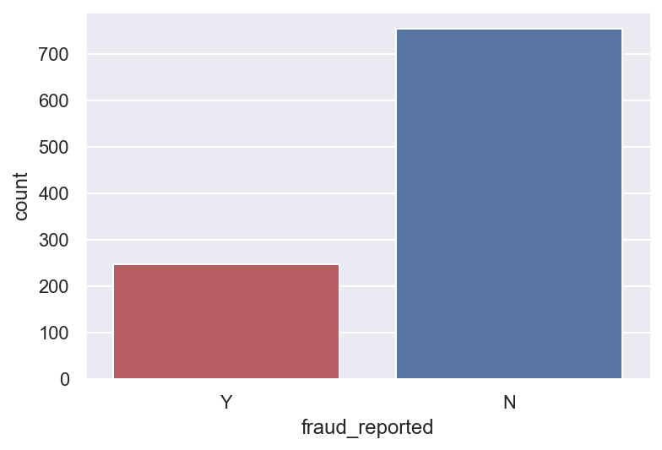
Fraud vs non-fraud claims
753 non-frauds
75.3%
247 frauds
24.7%
Notes:
¾ are non frauds and ¼ are frauds

Slide 12
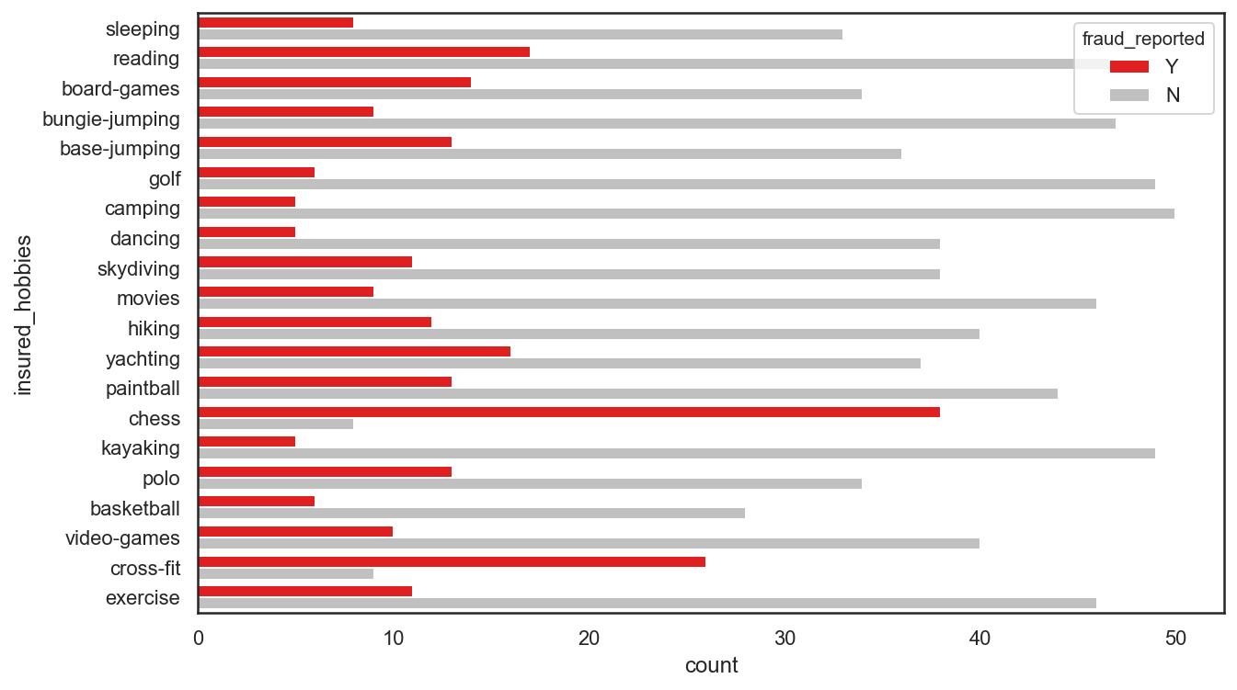
Notes:
There were 247 frauds and 753 non-frauds. 24.7% of the data were frauds while 75.3% were non-fraudulent claims.

Slide 13
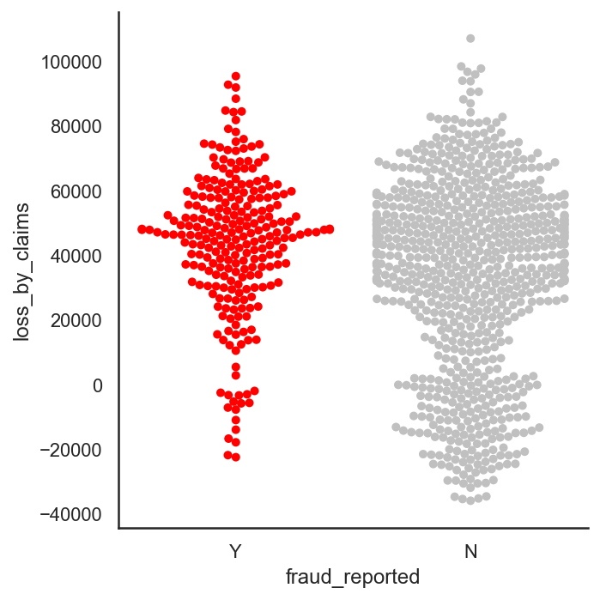
In 2 months, the insurance company lost $8,198,060.09 through fraudulent claims.
Frauds (M = 43752.03, SD = 21812.68) are significantly more expensive (p < .001) than non-frauds (M = 33368.68, SD = 29690.41).
Notes:
df['total_claim_amount'] - (df['policy_annual_premium'] * (2015 - df['policy_bind_year'])

Slide 14

Driver A
Months as customer: 116
Age: 34
Policy annual premium: $1737.66
Insured hobbies: Chess
Incident severity: Major Damage
Driver B
Months as customer: 190
Age: 40
Policy annual premium: $965.21
Insured hobbies: Camping
Incident severity: Trivial Damage
Notes:
Who is the fraudster?

Slide 15
Pre-processing

Slide 16
Pre-processing
Interaction terms
property claim amount and incident severity,
vehicle claim amount and incident severity,
injury claim amount and incident severity,
total claim amount and incident severity,
policy annual premium and total claim amount,
umbrella limit and total claim amount.
Notes:
What is auto insurance fraud:
Auto insurance fraud ranges from misrepresenting facts on insurance applications and inflating insurance claims to staging accidents and submitting claim forms for injuries or damage that never occurred, to false reports of stolen vehicles.
BI estimates that the total cost of insurance fraud (excluding health insurance) is more than $40 billion per year. (think about the cost of every fraud not just insurance, how big would that be?)
Fraud accounted for between 15 percent and 17 percent of total claims payments for auto insurance bodily injury in 2012, according to an Insurance Research Council (IRC) study. The study estimated that between $5.6 billion and $7.7 billion was fraudulently added to paid claims for auto insurance bodily injury payments in 2012, compared with a range of $4.3 billion to $5.8 billion in 2002.
Bottom line: fraud is on the rise, fraud is expensive
Source: https://www.iii.org/article/background-on-insurance-fraud

Slide 17
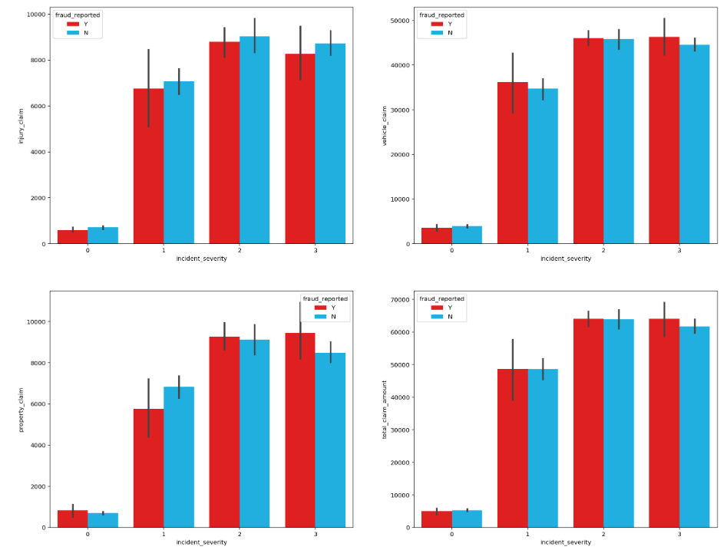
Notes:
Can sort of see that frauds differ on different levels of claims and severity

Slide 18
Pre-processing
Interaction terms
DV coded as 1 for fraud, 0 for non-fraud
Nominal variables were one-hot encoded
Ordinal data was treated as continuous
Data set was split into 75% train and 25% test set, stratified on fraud reported.
Notes:
What is auto insurance fraud:
Auto insurance fraud ranges from misrepresenting facts on insurance applications and inflating insurance claims to staging accidents and submitting claim forms for injuries or damage that never occurred, to false reports of stolen vehicles.
BI estimates that the total cost of insurance fraud (excluding health insurance) is more than $40 billion per year. (think about the cost of every fraud not just insurance, how big would that be?)
Fraud accounted for between 15 percent and 17 percent of total claims payments for auto insurance bodily injury in 2012, according to an Insurance Research Council (IRC) study. The study estimated that between $5.6 billion and $7.7 billion was fraudulently added to paid claims for auto insurance bodily injury payments in 2012, compared with a range of $4.3 billion to $5.8 billion in 2002.
Bottom line: fraud is on the rise, fraud is expensive
Source: https://www.iii.org/article/background-on-insurance-fraud

Slide 19
Modeling & Evaluation

Slide 20
Baseline score
If we make a naïve prediction and just predict everything to be fraud:
Sensitivity: 1.0
Specificity: 0.0
Precision: 0.248
F1 score: 0.397
ROC AUC Score: 0.50 (aim for 0.70)
Notes:
As our dataset is imbalance, accuracy is not a good measure of success. A high accuracy can be achieved by a poor model that only selects the majority class, hence, not detecting and measuring the accuracy of classifying the class of interest. In fact, predicting only the majority class will give an accuracy of 75%, specificity of 100% but a sensitivity of 0%.
As identifying as many frauds as possible is the goal, the F1 score of 0.397 was used as a baseline. However, investigations into frauds can be time consuming and expensive and may even affect customer experience. Thus, ROC AUC score will also be used to measure how well we distinguish between Fraud and legit claims. The baseline ROC AUC score is 0.50. I am to have a ROC AUC of at least 0.70.

Slide 21
Step 1
Hyperparameter tuning without oversampling
Hyperparameter tuning without SMOTE
- Logistic regression
- K-nearest neighbors
- Random forest
- XGBoost
- AdaBoost
Hyperparameter tuning without ADASYN
Hyperparameter tuning without bootstrap
Notes:
Systematic minority oversampling technique
Identify a minority class
Find its knn (usually 5)
Randomly choose one of the 5
Draw a line between the identified point and the selected neighbor
Find a point in the middle of them
Repeat until required sample size
Identified point + (difference with neighbor) * random number between 0-1

Slide 22
Step 1
Hyperparameter tuning without oversampling
Step 2
Hyperparameter tuning without SMOTE
- Logistic regression
- K-nearest neighbors
- Random forest
- XGBoost
- AdaBoost
Pick best models for ensemble
Hyperparameter tuning without ADASYN
Hyperparameter tuning without bootstrap

Slide 23
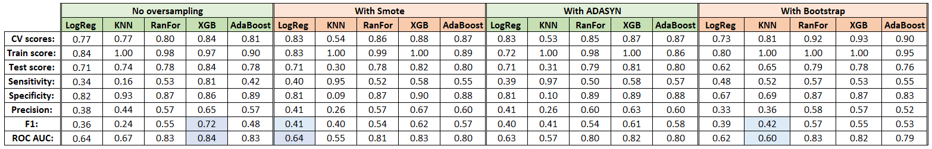
Notes:
Logistic regression with SMOTE (F1: 0.41)
KNN with bootstrapping (F1: 0.42)
Weighted XGBoost (F1: 0.72)

Slide 24
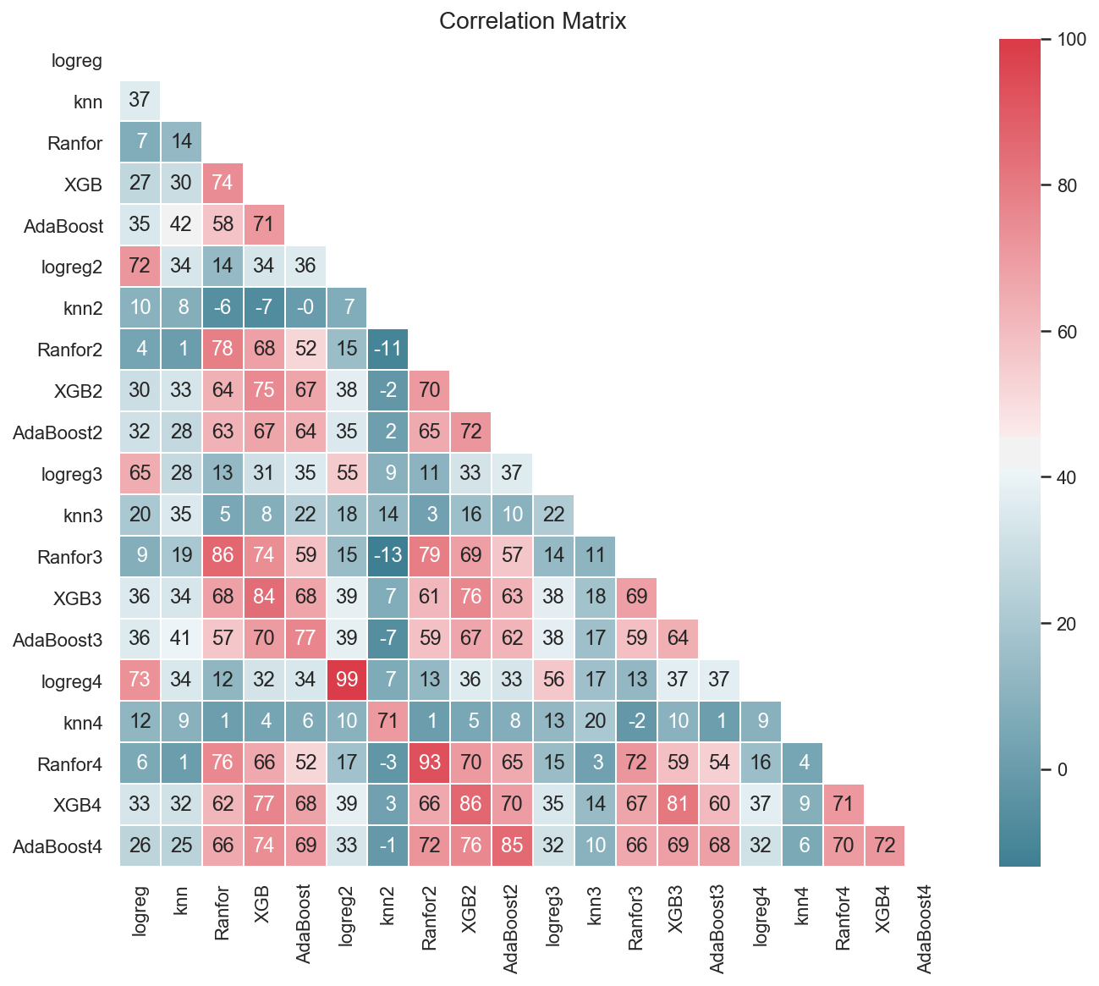
Notes:
Before ensemble, correlations of the predictions were ran. XGB, Random forest and AdaBoost have high correlation, perhaps as they all are CARTs (classification and regression tress). Other than that, models seem to capture different aspects of the feature space, as shown by the small to average correlation (Pearson’s heuristics) of their predictions.
Logistic regression with SMOTE (F1: 0.41)
KNN with bootstrapping (F1: 0.42)
Weighted XGBoost (F1: 0.72)

Slide 25
Step 1
Step 3
Hyperparameter tuning without oversampling
Max voting ensemble
Step 2
Hyperparameter tuning without SMOTE
- Logistic regression
- K-nearest neighbors
- Random forest
- XGBoost
- AdaBoost
Max voting with oversampling
Pick best models for ensemble
Hyperparameter tuning without ADASYN
Blending ensemble
Blending with oversampling
Hyperparameter tuning without bootstrap

Slide 26
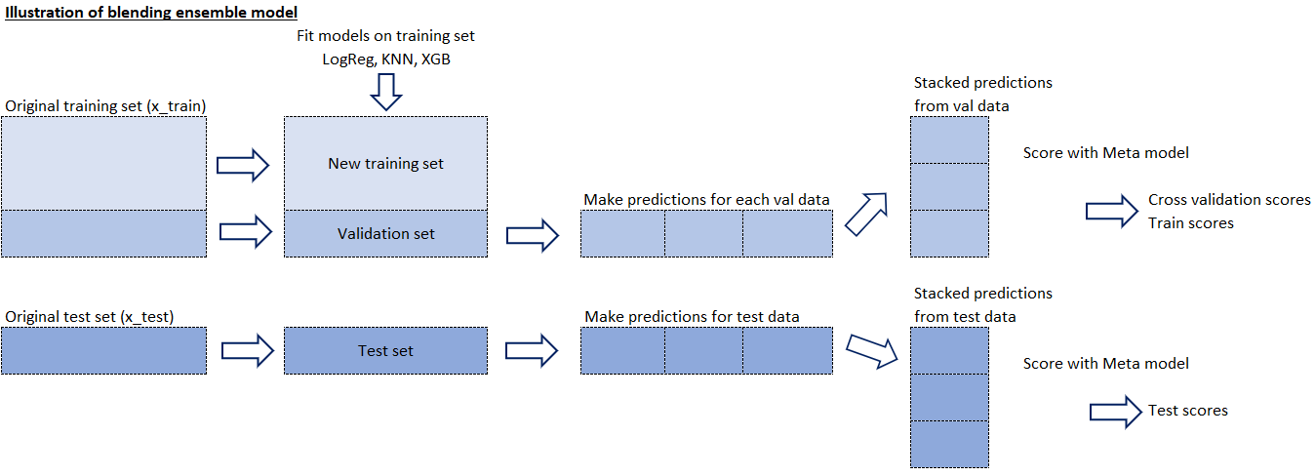
Notes:
so in max voting all models have same weightage.... but in reality some models may actually perform better or are better suited for that data.... so a way to do it is to manually weight the model... but that introduces bias...
a more accurate way is to use stack/blend....so the first stage seems like max vote but u use a meta model to weight them instead of weighting them urself. it weights through the meta model by minimizing the loss function of the metamodel which comes out with weights which is why linear models are preferred but other models may be used as meta too

Slide 27
Step 1
Step 3
Hyperparameter tuning without oversampling
Max voting ensemble
Step 2
Hyperparameter tuning without SMOTE
- Logistic regression
- K-nearest neighbors
- Random forest
- XGBoost
- AdaBoost
Max voting with oversampling
Pick best models for ensemble
Hyperparameter tuning without ADASYN
Blending ensemble
Blending with oversampling
Hyperparameter tuning without bootstrap
Step 4
Evaluate all 29 models and pick the best model

Slide 28
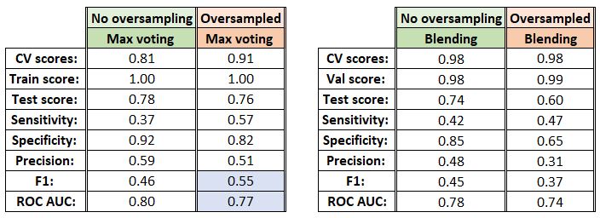

Slide 29
Final Model: Weighted XGBoost
Notes:
scale_pos_weight = total_negative_examples / total_positive_examples

Slide 30
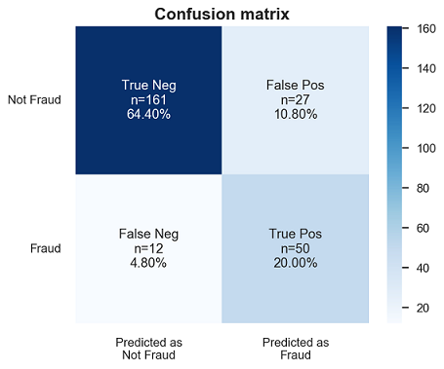
Train score: 0.967
Test score: 0.844
Train – Test = 0.123
CV score: 0.840
Sensitivity: 0.81
Specificity: 0.86
Precision: 0.65
F1: 0.72
Notes:
the model had a training accuracy score of 0.967 and a test accuracy of 0.844. The high accuracy score hint of a low bias (it is only a hint as accuracy is not a good measure of bias in imbalance class problems). An accuracy score difference of 0.123 between train and test is relatively small. Thus, this model can be said to have low variance and is generalizable on unseen data.

Slide 31
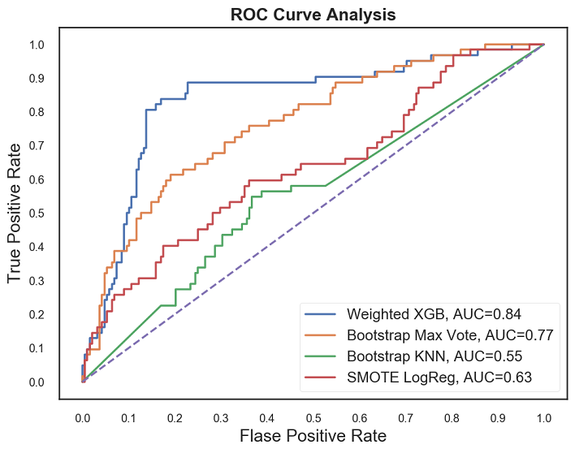
Notes:
Although our model performed better in predicting non-fraud cases, the model has performed very well on fraud cases as well. We have a higher false alarm than frauds escaping the detection. It is better in our case to identify more frauds than to let fraud cases escape detection.
Thus, this model has succeeded in its purpose to detect fraud claims. Unlike the baseline model that sacrifices too much resources into investigations and hinder customer experience, we are also able to balance this out in this model. We can detect more fraud and we are able to balance this with correct prediction of non-fraud cases.

Slide 32
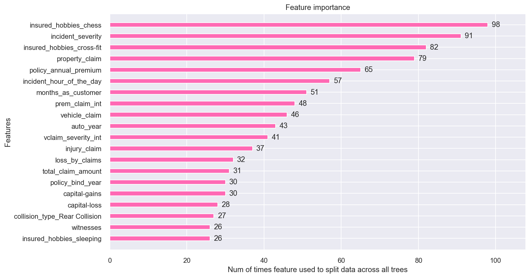
Notes:
Weight:
The number of times a feature is used to split the data across all trees. The final measure, implemented exclusively in XGBoost, is counting the number of samples affected by the splits based on a feature.
The figure below summarizes the top 20 ranked by feature importance, based on weight. Drivers with hobbies such as chess, cross-fit seemed to be more prone to frauds. Incident severity and property claim are amongst the highest as well. Interaction terms such as premium and total claim amount, vehicle claim amount and incident severity were also top features by weight.
Color box for more visual

Slide 33
Driver A
Months as customer: 116
Age: 34
Policy annual premium: $1737.66
Insured hobbies: Chess
Incident severity: Major Damage
Incident hour: 1am
Total claim: $97080
Driver B
Months as customer: 190
Age: 40
Policy annual premium: $965.21
Insured hobbies: Camping
Incident severity: Trivial Damage
Incident hour: 10am
Total claim: $6300
Notes:
0-5am and 3pm has most accidents

Slide 34
Conclusion
Using machine learning, I built a model that can accurately predict fraud
Cut loss = more profit
Accuracy = no wasted resources on investigating false alarms
Without compromising customer experience
Fair to honest customers
Potentially offer more competitive pricing
Notes:
months_as_customer 116
age 34
policy_bind_date 2012
policy_annual_premium 1737.66
insured_sex MALE
insured_hobbies chess
incident_severity Major Damage
incident_hour_of_the_day 1am
total_claim_amount 97080
auto_make BMW X5
fraud_reported Y
months_as_customer 190
age 40
policy_bind_date 2007
policy_annual_premium 965.21
insured_sex FEMALE
insured_hobbies camping
incident_severity Trivial Damage
incident_hour_of_the_day 10am
total_claim_amount 6300
auto_make Nissan Ultima
fraud_reported N

Slide 35
Limitation
Very small dataset
Dataset limited to first 2 months of 2015
Results limited generalizability to Ohio, Illinois, Indiana
Doesn’t define the type of auto insurance fraud
Notes:
Many times company or projects start out … don’t have huge data ….if you wait until you have huge data
you may not be making the best date driven decisions until then
you may not even reach that stage
you may also be collecting data that may not be useful…
So you should start early!
Small steps in right direction will help you progress faster than not doing any analysis

Slide 36


THANK YOU
Iceasher@gmail.com
+65 9325 9474
linkedin.com/in/iceasherchew
GitHub: https://github.com/iceasherchew
Medium post: https://tinyurl.com/sv9yw6j

